Slide 1
Bias from specification OR Measurement

Slide 2
Anscombe’s quartet a lesson in model fit

Slide 3
Anscombe's Quartet
 | x1 | y1 |  | x2 | y2 |  | x3 | y3 |  | x4 | y4
1 | 10 | 8.04 |  | 10 | 9.14 |  | 10 | 7.46 |  | 8 | 6.58
2 | 8 | 6.95 |  | 8 | 8.14 |  | 8 | 6.77 |  | 8 | 5.76
3 | 13 | 7.58 |  | 13 | 8.74 |  | 13 | 12.74 |  | 8 | 7.71
4 | 9 | 8.81 |  | 9 | 8.77 |  | 9 | 7.11 |  | 8 | 8.84
5 | 11 | 8.33 |  | 11 | 9.26 |  | 11 | 7.81 |  | 8 | 8.47
6 | 14 | 9.96 |  | 14 | 8.1 |  | 14 | 8.84 |  | 8 | 7.04
7 | 6 | 7.24 |  | 6 | 6.13 |  | 6 | 6.08 |  | 8 | 5.25
8 | 4 | 4.26 |  | 4 | 3.1 |  | 4 | 5.39 |  | 19 | 12.5
9 | 12 | 10.84 |  | 12 | 9.13 |  | 12 | 8.15 |  | 8 | 5.56
10 | 7 | 4.82 |  | 7 | 7.26 |  | 7 | 6.42 |  | 8 | 7.91
11 | 5 | 5.68 |  | 5 | 4.74 |  | 5 | 5.73 |  | 8 | 6.89
Mean | 9 | 7.5 |  | 9 | 7.5 |  | 9 | 7.5 |  | 9 | 7.5
Variance | 11 | 4.12 |  | 11 | 4.12 |  | 11 | 4.12 |  | 11 | 4.12
Correlation | 0.816 |  |  | 0.816 |  |  | 0.816 |  |  | 0.816
Regression | y = 3 + 0.5x |  |  | y = 3 + 0.5x |  |  | y = 3 + 0.5x |  |  | y = 3 + 0.5x
Four datasets that produce IDENTICAL descriptive stats, correlations, and regression models

Slide 4
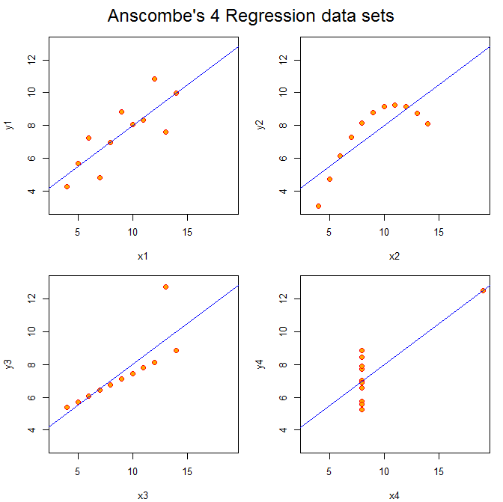
But they are very different
relationships!

Slide 5
Non-linear model
OK
Anscombe’s Quartet is often cited because (a) whoever created this example with pen and paper is a genius, and (b) it is a vivid demonstration of causes and consequences of specification bias.
We will consider what happens to slopes when outliers are present, or we use a linear specification when the relationship is non-linear.
outliers
outliers

Slide 6
Classes of inferential failure type I and type II errors

Slide 7
Type I Error
False positive
Claiming program has impact when it doesn’t
Type II Error
False NEGATIVE
Failing to identify true program impact
True program impact
No true program impact
bias causes non-significance
bias causes significance
bias causes significance
Increase in SE’s causes non-significance
Type I errors are typically caused by OVB
Type II Errors can be caused by bias or inflated standard errors

Slide 8
Implications of measurement error

Slide 9
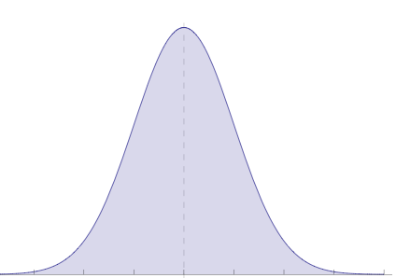
Add 100 to X
var(x) = s
var(x+100) = s
mean(x) = u
mean(x+100) = u+100
“Linear Transformations”
X2 = X1 + 100
Variance of X is unchanged

Slide 10
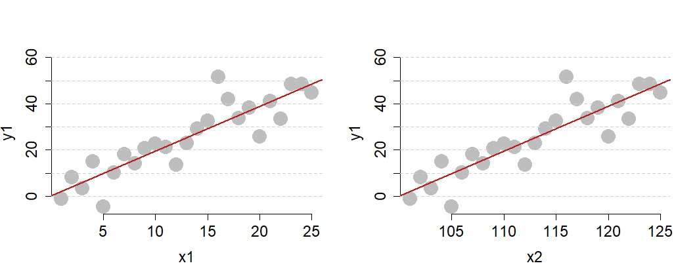
Add 100 to X
var(x) = s
var(x+100) = s
mean(x) = u
mean(x+100) = u+100
After linear transformations:
Regressions are unaffected

Slide 11
Add 100 to X
var(x) = s
var(x+100) = s
mean(x) = u
mean(x+100) = u+100
“Linear Transformations”
X2 = X1 + 100
Must add the same constant to every value of X
Just moves the distribution to right or left

Slide 12
X1
Measurement Error
X2 = X1 + ε
var(x1) = s
mean(x1) = u
Add random error to every X.
Random means each X is equally likely to be over-measured as under-measured.
X2 has the same mean as X1, but more variance
X2
var(x2) = s+ ε
mean(x2) = u

Slide 13
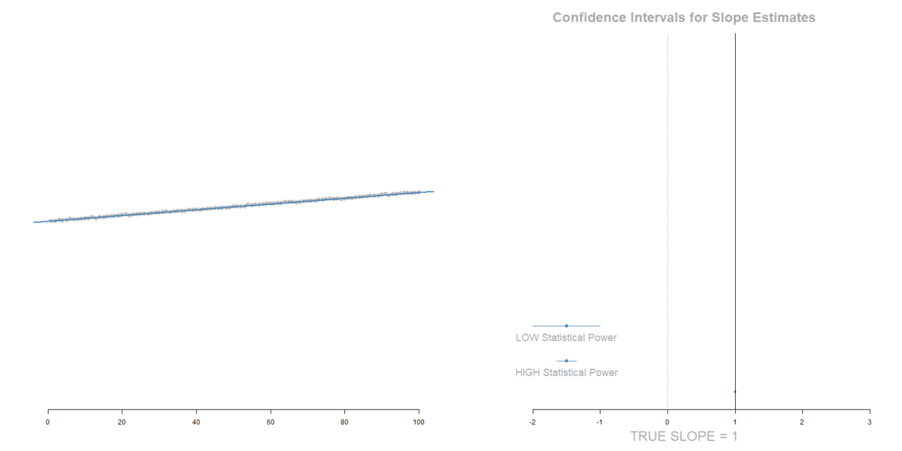
Adding Measurement Error to the DV
(no bias)
Increase in standard errors
Type II Error risk

Slide 14
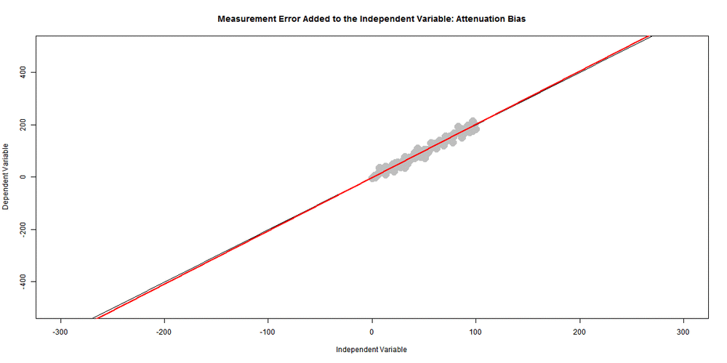
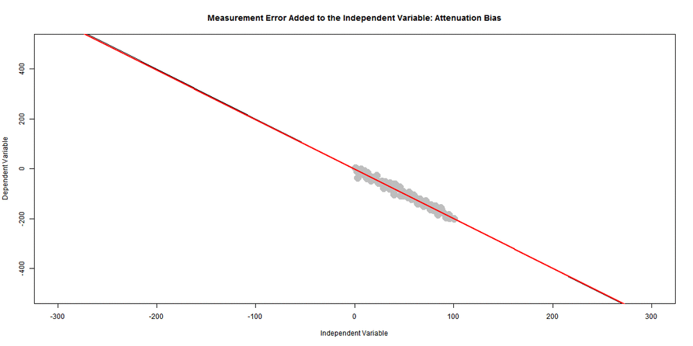
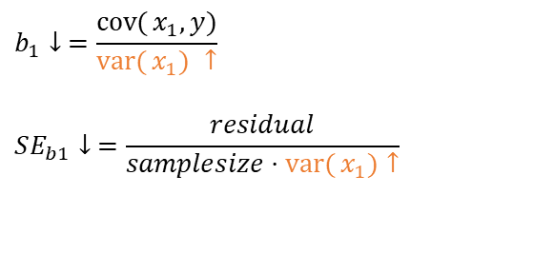
Adding Measurement Error to the independent variable:
“Attenuation bias”
Toward b1=zero
True program impact
slope with measurement
error
Smaller slope
Smaller SE
Toward b1=zero
$$b_{1}↓ =\frac{\operatorname{cov}{(}x_{1},y)}{\operatorname{var}{(}x_{1}) ↑}$$
$$SE_{b1}↓ =\frac{residual}{samplesize⋅\operatorname{var}{(}x_{1})↑}$$

Slide 15
outliers

Slide 16
Slopes too large
SE larger
Slopes ok
SE larger
Slopes too small
SE larger
Extreme of X:
Risk of bias in slope ↑
Risk of false positive
Middle of X:
Don’t bias slope
Increased risk of false negative
Extreme of X:
Risk of bias in slope ↓
Increased risk of false negative

Slide 17
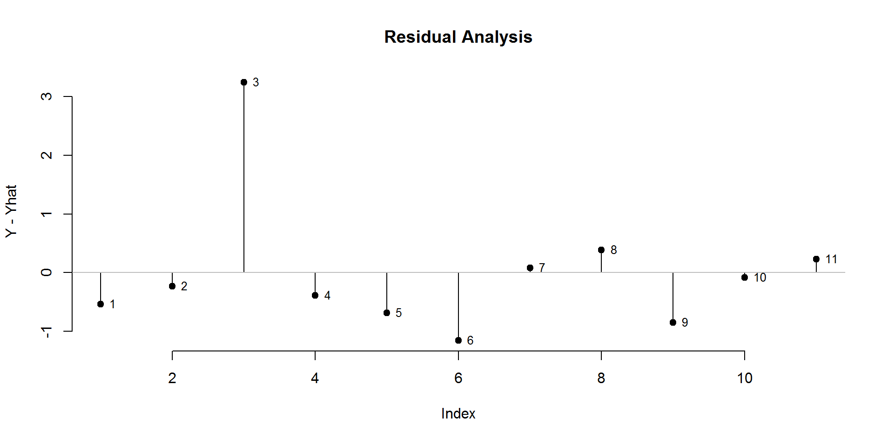

Slide 18
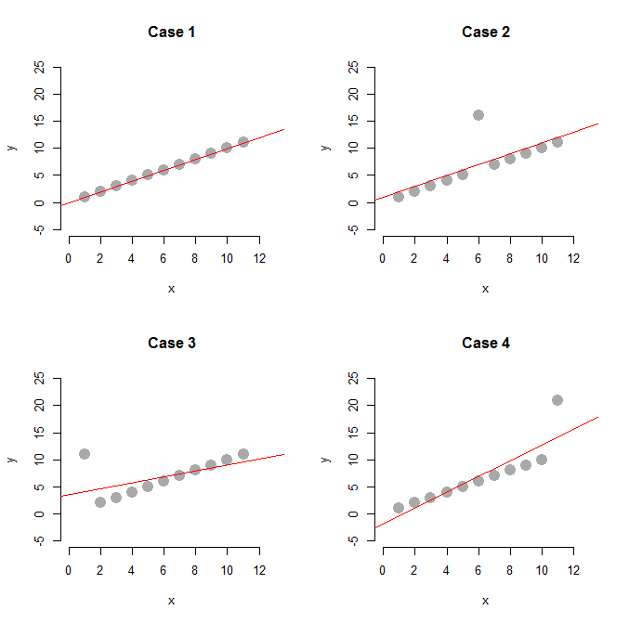
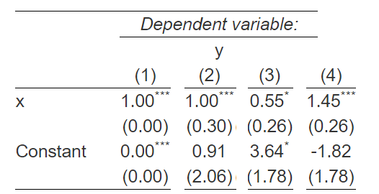

Slide 19
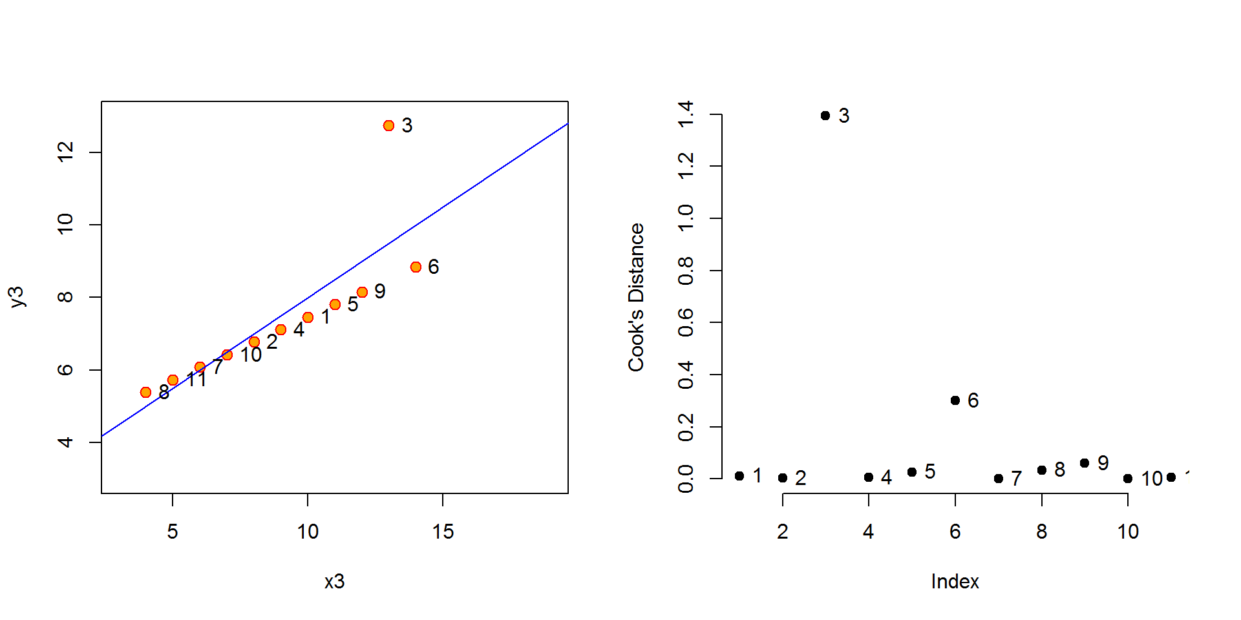

Slide 20
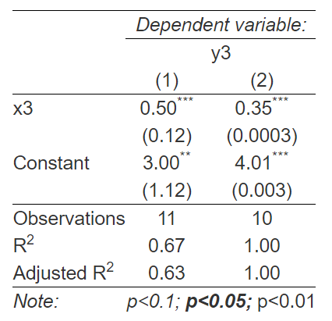
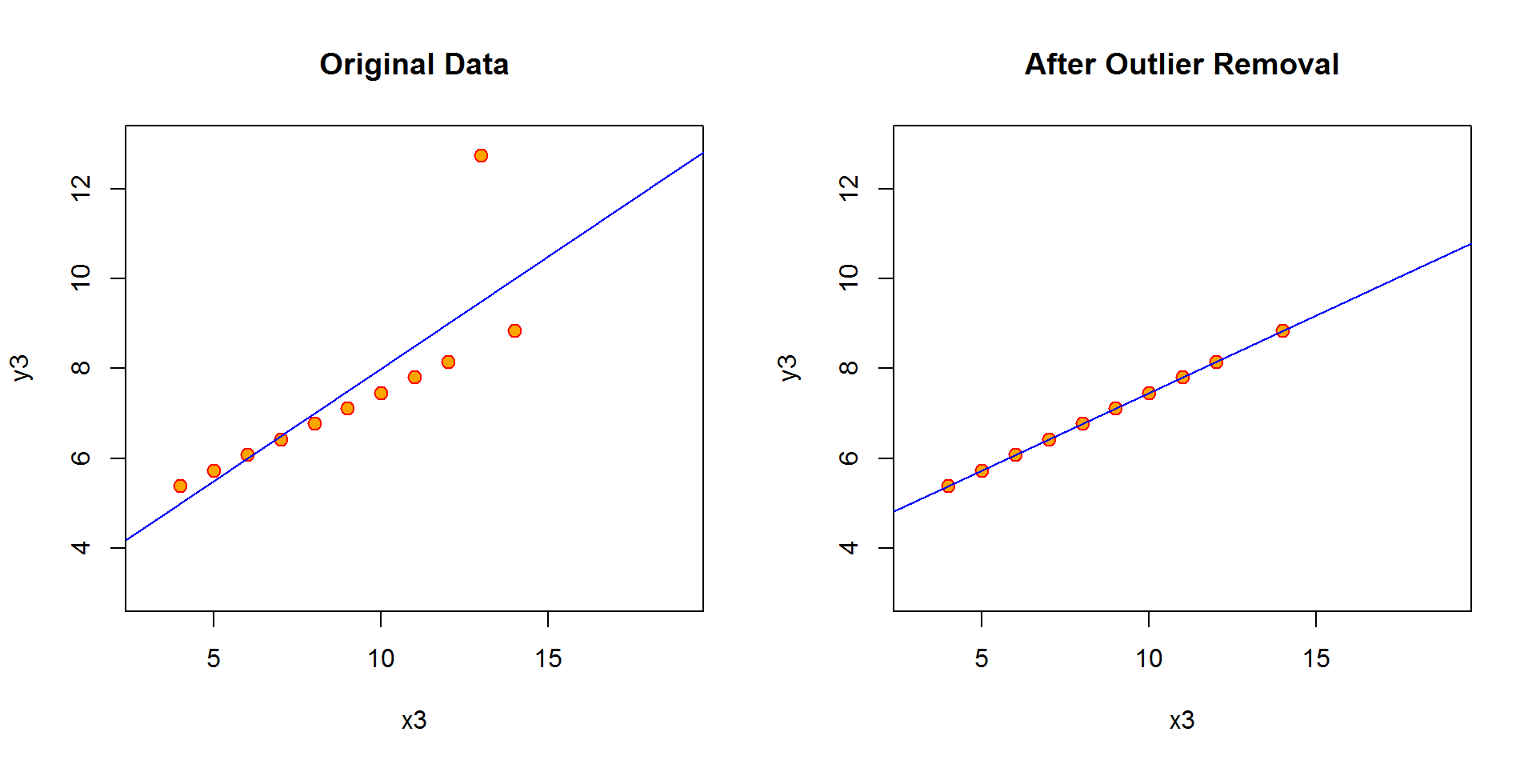

Slide 21
Non-Linear Relationships quadratic models

Slide 22
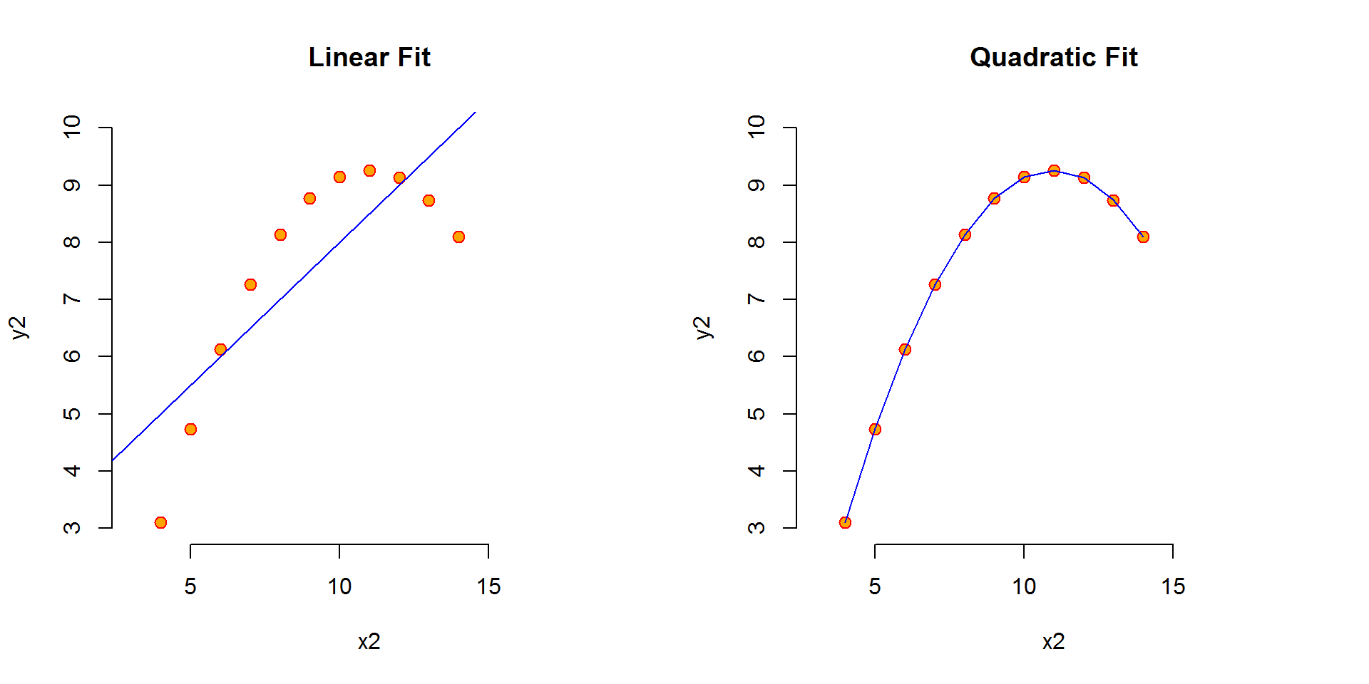

Slide 23
Interacting dummy variables: the difference-in-difference model

Slide 24
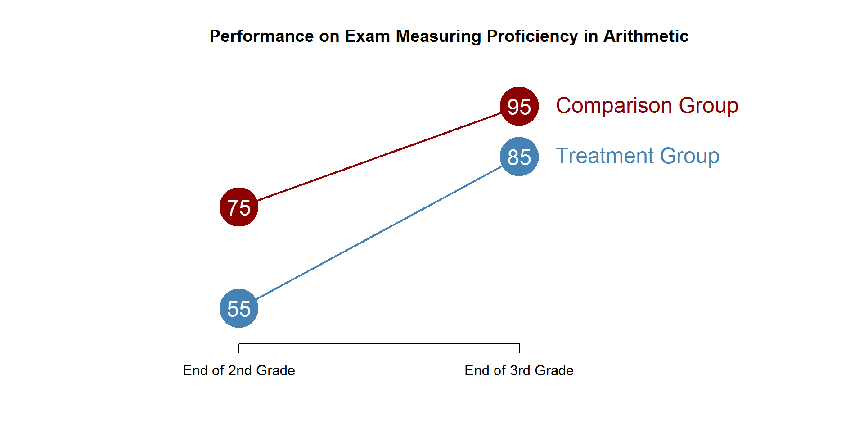

Slide 25
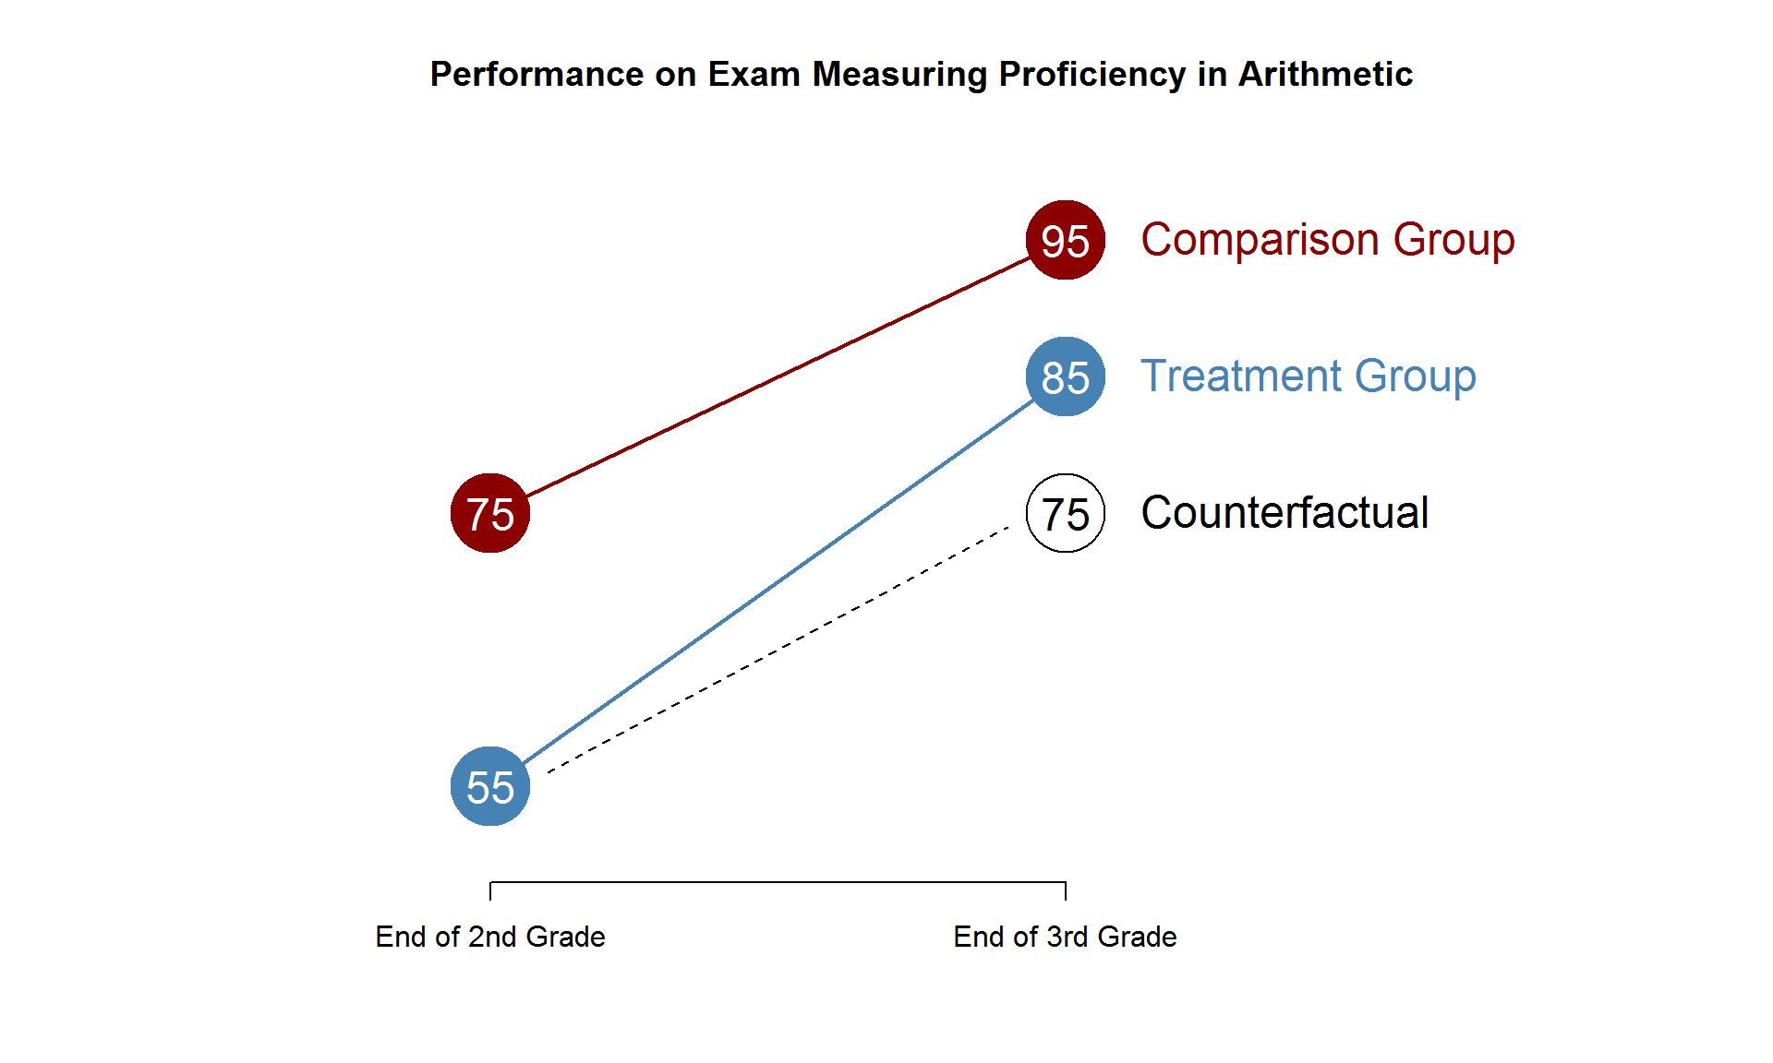

Slide 26
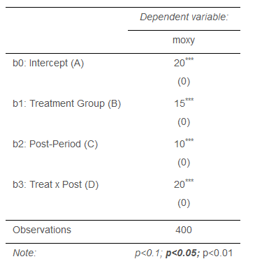
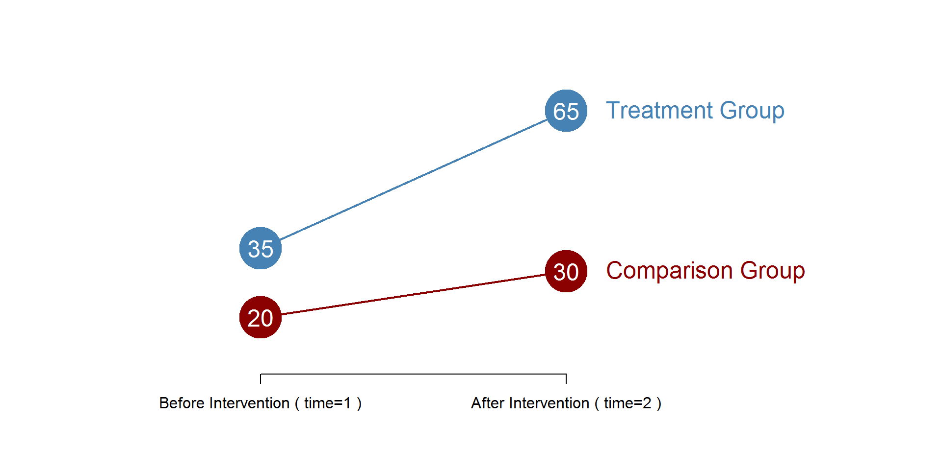

Slide 27
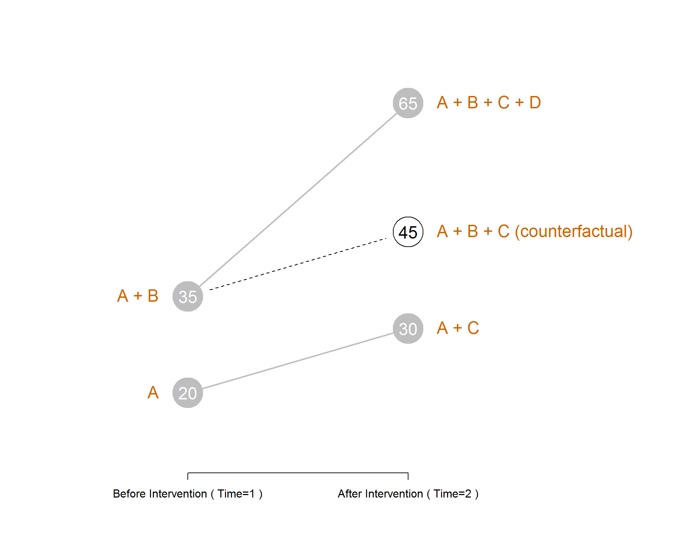

Slide 28
Interacting Slopes: Varying program impact by Group

Slide 29
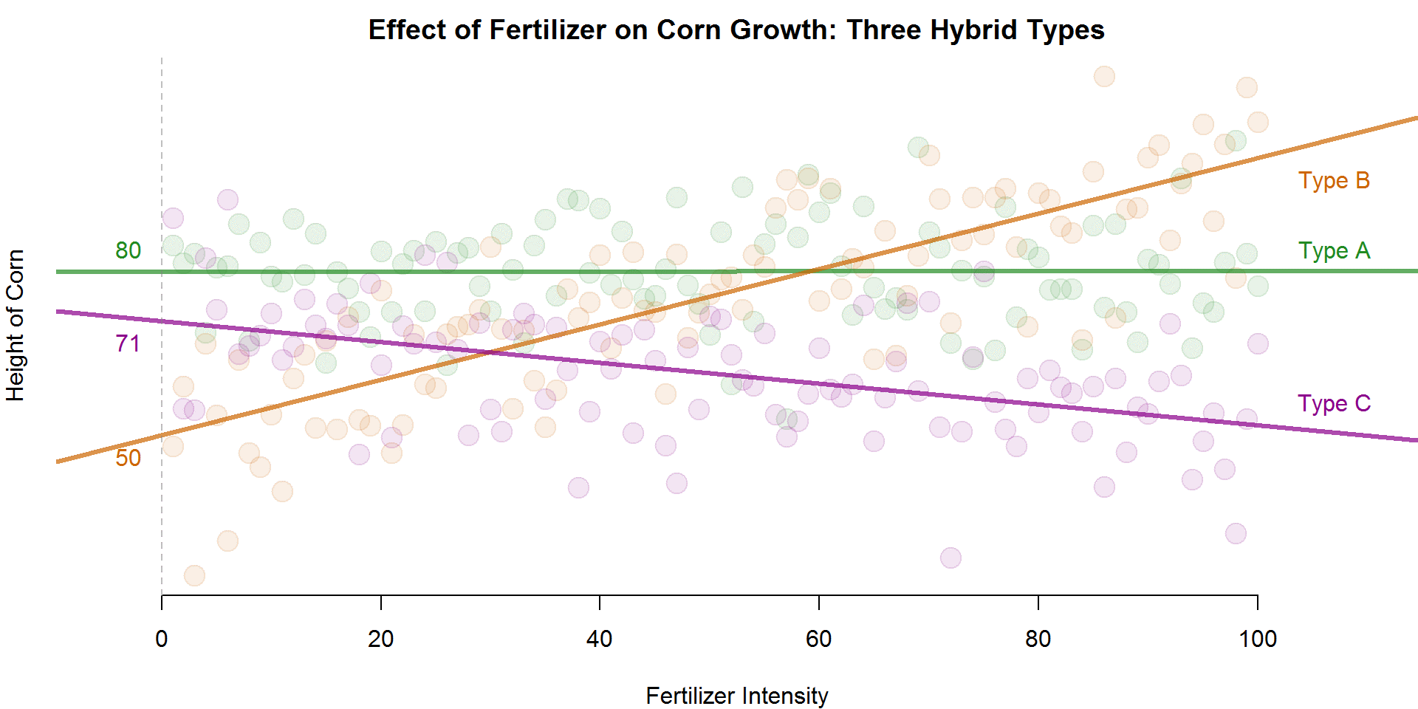
$$height= b_{0}+b_{1}dumA+b_{2}dumB+b_{3}fertilizer+b_{4}dumA∗fertilizer+b_{5}dumB∗fertilizer+e$$
Height of Type C at fertilizer=0
Height of Type A above height of Type C at fertilizer=0

Slide 30
$$height= b_{0}+b_{1}dumA+b_{2}dumB+b_{3}fertilizer+b_{4}(dumA∙fertilizer)+b_{5}(dumB∙fertilizer)+e$$
Impact of fertilizer intensity on height for Type C
Difference in fertilizer slope between Type A and Type C
Fertilizer slope for Type A: b₃ + b₄

Slide 31
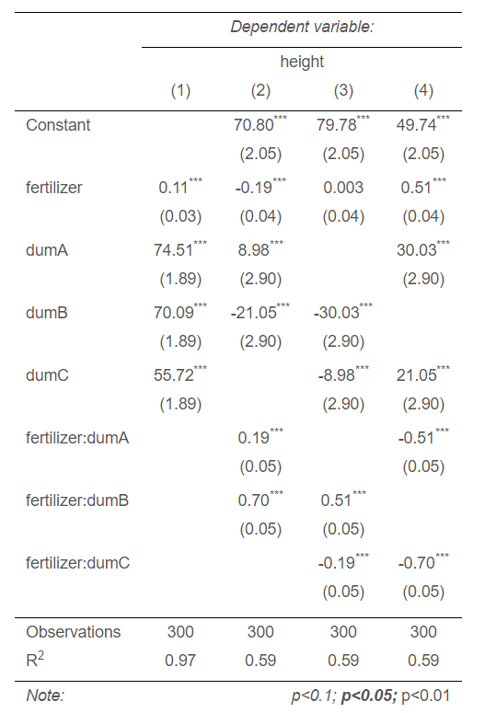
$$height= b_{0}+b_{1}dumA+b_{2}dumB+b_{3}fertilizer+b_{4}dumA∗fertilizer+b_{5}dumB∗fertilizer+e$$

